Slide 1
Signed Binary Numbers
Negative decimal numbers are -1, -2, -3, etc
For binary numbers, positive sign is 0 and negative sign is 1, so:
In binary 0001 means +1 and 1001 means -1
In binary 0010 means +2 and 1010 means -2, etc
Such numbers are called signed binary numbers or sign-magnitude numbers

Slide 2
Sign-Magnitude Numbers Example
Decimal number | Binary Signed-Magnitude Representation
+7 | 0000 0000 0000 0111
-7 | 1000 0000 0000 0111
+25 | 0000 0000 0001 1001
-25 | 1000 0000 0001 1001

Slide 3
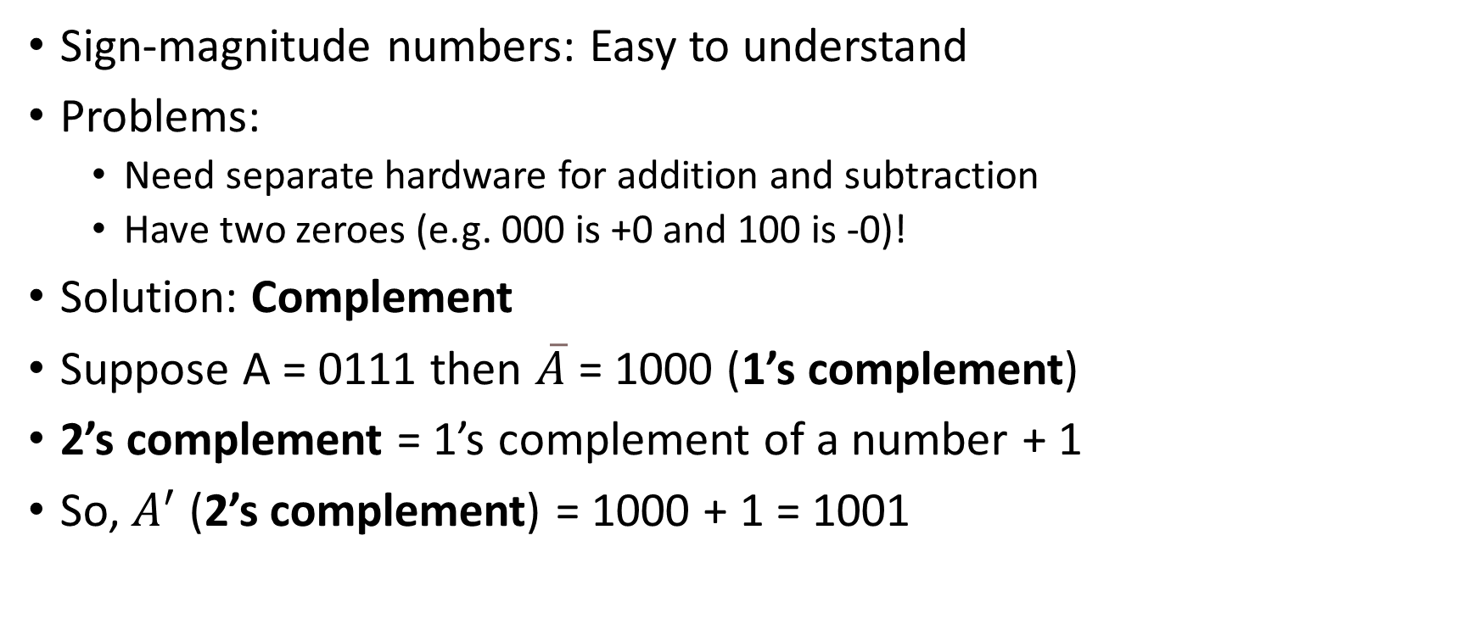
2’s Complement
Sign-magnitude numbers: Easy to understand
Problems:
Need separate hardware for addition and subtraction
Have two zeroes (e.g. 000 is +0 and 100 is -0)!
Solution: Complement
Suppose A = 0111 then $\overline{A}$ = 1000 (1’s complement)
2’s complement = 1’s complement of a number + 1
So, $A^{′}$ (2’s complement) = 1000 + 1 = 1001

Slide 4
Calculate 2’s Complement
Calculate 2’s complement of the following numbers:
0110
0001
1000
1001

Slide 5
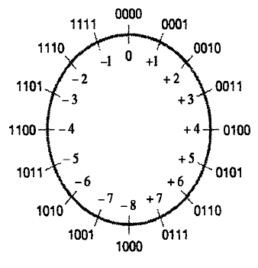
2’s Complement Representation

Slide 6
2’s Complement: Important Point
If we take the 2’s complement of a number twice, we get the original number
Example:
A = 0111
Ā = 1000
A’ = 1000 + 1 = 1001
So we now start with A = 1001
Ā = 0110
A’ = 0110 + 1 = 0111, which was our original number
So, we can say that A’’ = A

Slide 7

Sample Binary Odometer with Negative and Positive Numbers
Double complement logic
Consider a positive number 0010 in binary, i.e. 2 in decimal
Its 1’s complement is 1101
So, its 2’s complement is 1110
1110 in decimal is -2
So, 0010 (i.e. +2) and 1110 (i.e. +2) are 2’s complements of each other
1101
1110
1111
0000
0001
0010
0011
Negative numbers
Positive numbers
Taking a 2’s complement of a number is the same as changing its sign (i.e. positive to negative or vice versa)

Slide 8
2’s Complement and Binary Arithmetic
With sign-magnitude numbers, we require separate digital circuits for binary addition and subtraction
With 2’s complement, we can use a simple digital circuit to perform both addition and subtraction – how?
Consider two binary calculations: 0101 + 0010 and 0101 – 0010
Addition is simple
To perform subtraction, we take 2’s complement of the second number: 0010->1’s complement: 1101-> 2’s complement: 1110
We then add (and not subtract) the second number to the first number
Summary: We use add circuit for subtraction also – See next slide

Slide 9
2’s Complement and Binary Arithmetic
Addition
0101 (+5)
+ 0010 (+2)
-------------
0111 (+7)
Subtraction using 2’s complement
0101 (+5)
+ 1110 (-2)
-------------
0011 (+3)
Normal Subtraction would be …
0101 (+5)
- 0010 (+2)
-------------
0011 (+3)
To subtract 0010 from 0101, we first take 1’s complement of 0010, which is 1101. We then take the 2’s complement, which is 1110. We then add this 2’s complement to the first number, although this is a subtraction operation.

Slide 10
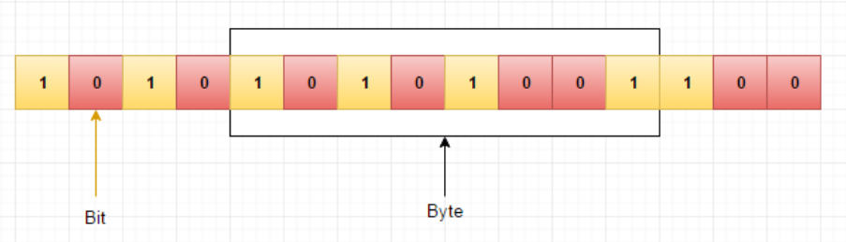
Storage of Data in Memory

Slide 11
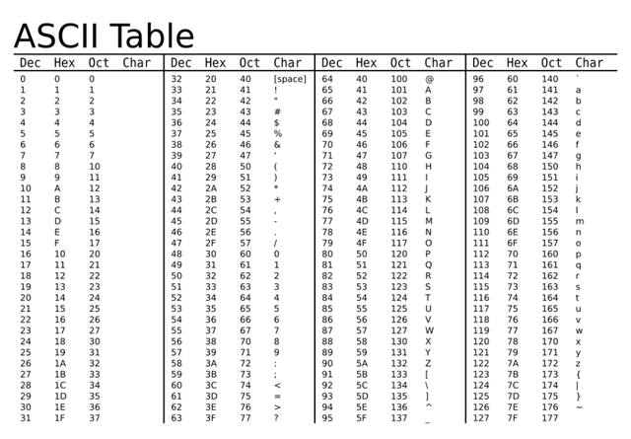
How are Characters Stored in Memory?

Slide 12
Character Data Storage
Each character is stored using its 8-bit ASCII representation in binary
Example: Store a word cdac in memory as a string of characters
ASCII code for character c: 99 (decimal) = 01100011 (binary)
ASCII code for character d: 100 (decimal) = 01100100 (binary)
ASCII code for character a: 97 (decimal) = 01100001 (binary)
ASCII code for character c: 99 (decimal) = 01100011 (binary)
Summary: cdac will be stored in memory as
01100011011001000110000101100011

Slide 13
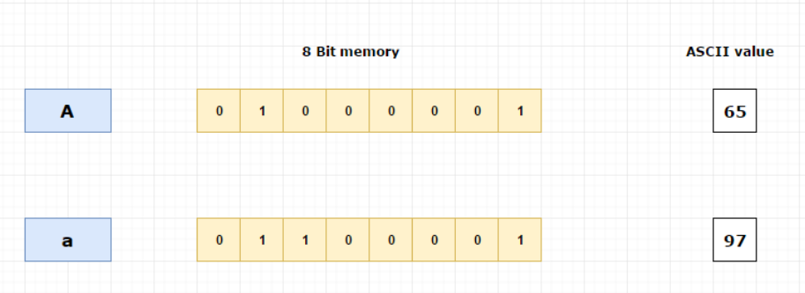
Character Storage Example

Slide 14
Positive Integers
4 bytes (32 bits) per integer, first bit for sign, remaining 31 bits for value
Example: Store integer 65 in memory
65 in binary = 00000000 00000000 00000000 01000001
MSB (most significant bit) = 0, since the number is positive
This binary equivalent of 65 will be stored in 32-bit memory:
00000000 00000000 00000000 01000001
Byte 4
Byte 3
Byte 2
Byte 1
00000000
00000000
00000000
01000001

Slide 15
Negative Integers
4 bytes (32 bits) per integer, first bit for sign, remaining 31 bits for value
Example: Store integer -65 in memory
Negative numbers = Use 2’s complement
65 in 32-bit binary = 00000000 00000000 00000000 01000001
2’s complement = 11111111 11111111 11111111 10111111
MSB (most significant bit) = 1, since the number is negative
Byte 4
Byte 3
Byte 2
Byte 1
11111111
11111111
11111111
10111111

Slide 16
Summary
Positive and negative numbers: +65 and -65
Byte 4
Byte 3
Byte 2
Byte 1
00000000
00000000
00000000
01000001
+65
11111111
11111111
11111111
10111111
-65

